Slide 1
Early Diagnosis of Lung Cancer Public Awareness Campaign
Pilot campaign in North Dublin
Campaign Partner Pack
29 July to 8 September 2024

Slide 2
Campaign overview
Over 2,500 cases of lung cancer are diagnosed each year in Ireland. Lung cancer is the leading cause of cancer mortality in both males and females in Ireland with over 1,900 deaths annually.
The HSE is piloting a regional early diagnosis of lung cancer public awareness campaign in the North Dublin area.
Why North Dublin?
Epidemiology
Incidence of lung cancer is higher in North Dublin relative to other areas
North Dublin has significant areas of deprivation and an older population compared to the rest of the country
Service readiness
Regional Cancer Prevention Officers in the area since 2022
There are two rapid access lung cancer clinics – Mater Hospital and Beaumont Hospital

Slide 3
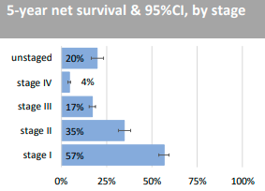
Campaign overview
If lung cancer is found early, it’s easier to treat and there’s a better
chance of recovery.
5-year survival for lung cancer based on stage of diagnosis
Stage 1 (early stage) is 57%
Stage 4 (late stage) is 4%
Most cases of lung cancer (97%) are diagnosed in people aged 50 and older. Additional risk factors include smoking/a past history of smoking and socioeconomic deprivation.
One of the common symptoms of lung cancer is a persistent new cough – this symptom is a key focus for the campaign.
The call to action is for people to contact their GP/doctor without delay if they develop a cough that does not go away after 3 weeks.

Slide 4
Campaign overview
Campaign key messages:
The earlier lung cancer is found, the better the chances of survival.
Contact your doctor / a doctor if you have a new cough lasting more than 3 weeks.
If a GP suspects a diagnosis of lung cancer, they can refer the patients to a Rapid Access Lung Clinic (in Dublin these include the Mater Hospital, Dublin 7, and Beaumont Hospital, Dublin 9). Rapid Access Lung Clinics have specialist staff and equipment so they can see patients with suspected lung cancer and arrange tests quickly.

Slide 5
Campaign plan and assets

Slide 6
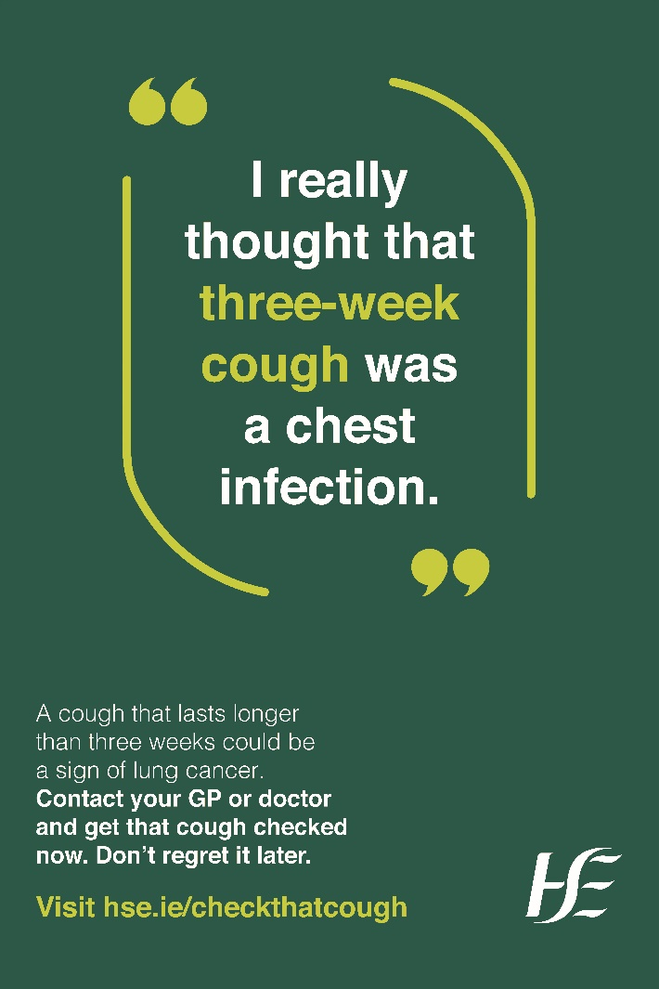
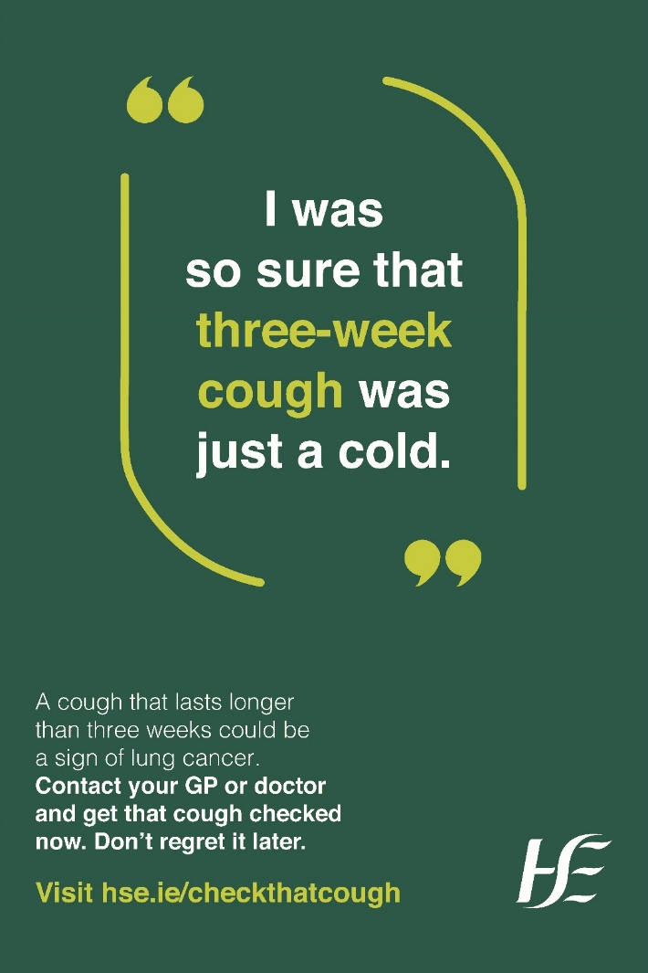
Campaign channels
29 July to 8 September
Out-Of-Home (OOH) ads at bus shelters, digitowers and ad boxes across identified areas of social deprivation in North Dublin (ads featured on the right)
Pharmacy screens in a small selection of North Dublin pharmacies
Press ads in Northside People (East and West publications)
Social media paid ads across Facebook
Community Promotion – this campaign pack sent to over 800 stakeholders in North Dublin to promote the campaign
OOH, pharmacy screen ads and press will also run in Irish copy

Slide 7
Resources for you
Online resources
(Right click on links below to open the hyperlink)
I really thought that 3 week cough was just a cold A4 poster
I thought that 3 week cough was just a cold DL leaflet
I thought that 3 week cough was a chest infection A4 poster
I thought that 3 week cough was a chest infection DL leaflet
Know the signs, find lung cancer early – A4 poster
Lung cancer, find cancer early – A4 factsheet

Slide 8
Resources for you
Printed resources
Contact prevention@cancercontrol.ie or lisa.odonnell@hse.ie for hard copies of the campaign A3 or A4 poster or leaflet
You can order hard copies of the Know the signs, find lung cancer early A4 poster and Lung cancer, find cancer early A4 factsheet from healthpromotion.ie. Search for the materials using the drop-down menus. Choose ‘Cancer’ in ‘Search by topic’ and use ‘Lung’ in the ‘Search by keyword’
Webpage
Health professionals: The posters and social media assets, as well as NCCP factsheets are available on www.hse.ie/cancerearlydetection
Public information: Visit www.hse.ie/checkthatcough

Slide 9
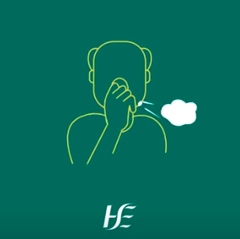
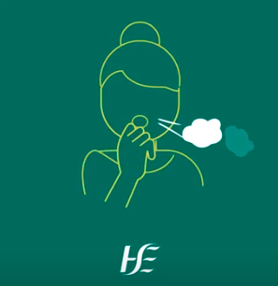
Social media
Please like and repost our messages. Right click on links below to open the hyperlink of the social media videos if you would like to share on your own channels also.
Messages will be shared on the following channels
Facebook: HSE Ireland
Instagram: @Irishhealthservice
X: @HSELive
Check that cough social media video with male voiceover
Check that cough social media video, male, square
Check that cough social media video, female square
Check that cough social media video, male 9 x 16
Check that cough social media video, female, 9 x 16
Know the signs, spot lung cancer early video

Slide 10
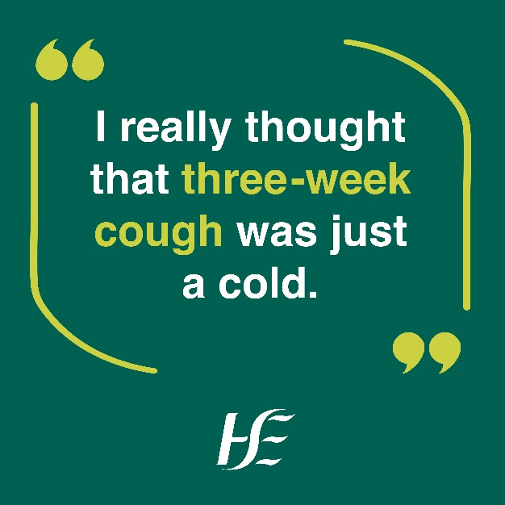
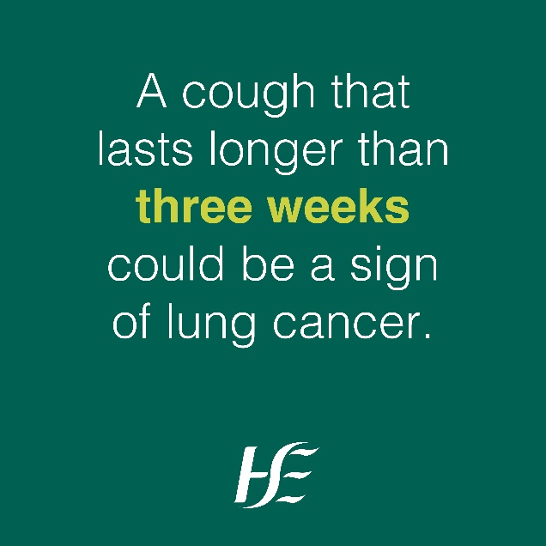
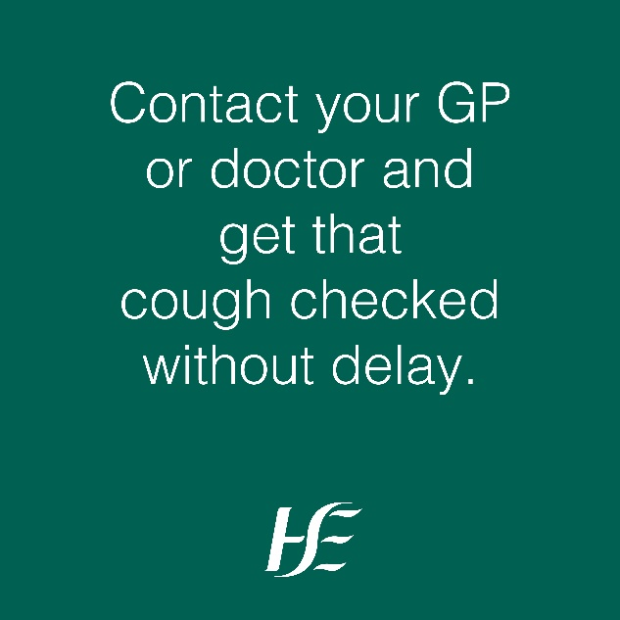
Social media
Please like and repost our messages. Right click on images to open the hyperlink of the social media videos/images if you would like to share on your own channels also.
Messages will be shared on the following channels
Facebook: HSE Ireland
Instagram: @Irishhealthservice
X: @HSELive

Slide 11
Social media sample content
A new cough that won’t go away? Contact your doctor as soon as possible. Don’t regret it later. www.hse.ie/checkthatcough
#KnowTheSigns
A cough lasting over 3 weeks could be a sign of lung cancer. Contact your doctor today. Don’t regret it later.
www.hse.ie/checkthatcough
#KnowTheSigns
Lung cancer is a very common and serious type of cancer. More than 2,500 people are diagnosed with it every year in Ireland.
A cough lasting over 3 weeks could be a sign of lung cancer. Contact your doctor today. Don’t regret it later.
www.hse.ie/checkthatcough
#KnowTheSigns
More than 9 in 10 people diagnosed with lung cancer in Ireland are age 50 and older. A cough lasting over 3 weeks could be a sign of lung cancer. Contact your doctor as soon as possible. Don’t regret it later.
www.hse.ie/checkthatcough
#KnowTheSigns
Early diagnosis can make a big difference to how treatable your lung cancer is.
A cough lasting over 3 weeks could be a sign of lung cancer. Contact your doctor as soon as possible. Don’t regret it later.
www.hse.ie/checkthatcough
#KnowTheSigns

Slide 12
How you can take part
We welcome you taking part. You can support the campaign by:
Printing the poster to display in public areas/notice boards/waiting areas
Sharing the message in any newsletters
Sharing with appropriate community WhatsApp groups
Sharing the social media posts on your organisation’s social media and your personal channels
Sharing with other colleagues working in the area and encouraging them to promote the campaign

Slide 13
Campaign research

Slide 14
Research and evaluation plan
Over 50s
Smoker/ex smoker
Through a specially designed research plan, we will:
Use pre-campaign surveys and focus groups to inform the design of the campaign materials
Use post-campaign surveys and additional evaluations to assess the performance
of the pilot campaign and the impact in North Dublin
This will be achieved in the following phases:
Pre-campaign surveys in the North Dublin area and a control group area
Qualitative testing – focus group with key audience to test creative concepts
Post-campaign surveys in the North Dublin area and a control group area
Full campaign evaluation report to measure the performance of the ads and the impact on GP e-Referrals to Rapid Lung Access Clinics
Key audience

Slide 15
Pre-campaign research overview
Face-to-face quantitative interviews conducted across disadvantaged areas in North Dublin (campaign/target area), and South Dublin (control area).
Sample size of 150 people in each area aged 50 or over who currently smoke or used to smoke (300 participants in total).
Focus was on measuring understanding, knowledge and awareness of symptoms, and help-seeking intent/behaviour.

Slide 16
Pre-campaign research results
Age
7%
Only 45% of people feel confident they could spot lung cancer symptoms.
12% unprompted said a persistent cough is a symptom of lung cancer
67% prompted agreed that a new cough lasting 3 weeks or more was a symptom
56% are worried about getting lung cancer, which includes 64% of people who smoke
The biggest barrier for going to the doctor with symptoms is that they would assume it’s a cold/the flu (64%)
50% say they have seen/ heard any ads about lung cancer in the past few months
1 in 3 of people who smoke say they do not intend on quitting smoking. The biggest reason (62%) being they tried before and failed.
8%
70-74
65-69
60-64
55-59
50-54
17%
26%
39%
Social Class
Smoking Habits
I do not currently smoke
19%
15%
I am a former smoker
18%
I smoke occasionally
14%
81%
I smoke daily
52%
0%
20% 40% 60%
ABC1
C2DE

Slide 17
Qualitative testing
Three options of campaign content were developed based off the keys results from the pre-campaign research.
A focus group of 8 participants in the target audience in North Dublin took place to test the 3 options.
The preferred option was deemed the most effective because the focus group thought it had a serious tone, the message was clear and the quote resonated with them and felt ‘true to life’.
Lung cancer being mentioned made it more serious and would encourage them to visit their GP.
Their children might see this and then encourage them to get checked out.

Slide 18
Contact information
Thank you for supporting this campaign.
For queries, please contact:
Ciara Browne, Programmes and Campaigns Officer, HSE, ciara.browne1@hse.ie
Áine Lyng, Cancer Prevention Officer, NCCP, prevention@cancercontrol.ie
Lisa O Donnell, Senior Health Promotion & Improvement Officer - Cancer Prevention CHO DNCC, lisa.odonnell@hse.ie
Website
Health professionals: www.hse.ie/cancerearlydetection
Public: www.hse.ie/checkthatcough

